Slide 1
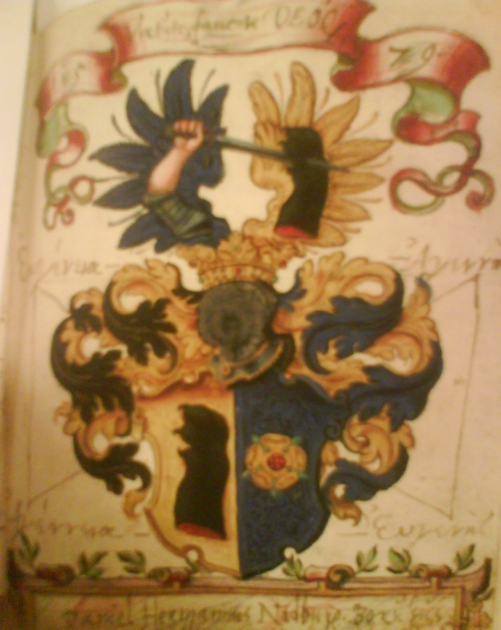
Alba amicorum at Lund University Library

Slide 2
Complete list of Alba amicorum (-1700) at Lund University Library
Krištof Kulicka (1556), German
Daniel Hermann (1566), German
Christian Poulsen Noviomagus (1589), Danish
Jonas Latomus (1597), German
Petrus Hieronymi Glandius (1603), Swedish
Michael Mauritius (1613), Danish (only copies at Lund University Library, original at Skabersjö castle)
Alewinus Petri (1619), Dutch
Martin Nordeman (1663), Danish (Scanian)
Petrus Beeth (1670) Swedish

Slide 3
The album of Daniel Hermann (b. 1543, d. 1601)

Slide 7
The album of Petrus Hieronymi Glandius (d. 1623)

Slide 12
Vita religione constat
Gustavus Adolphus Dux Sudermanniae

Slide 13
Nulli praeclusa est virtus, omnes admittit, nec sexum nec censum eligit
Maria Elizabetha Princeps Sudermanniae

